Slide 1
Web Mining

Slide 2
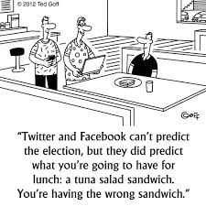

Slide 3

Web mining
Web mining helps to solve the problem of discovering how users are using Web sites. It involves mining logs (or log analysis) and the steps that typically have to be gone through to get meaningful data from Web logs - data collection, pre-processing, data enrichment and pattern analysis and discovery.

Slide 4
Terminologies
To provide some industry level consistency, the World Wide Web Committee (W3C) has produced definition of terms such as users, clickstreams and page views amongst others. With an agreed set of definitions, comparisons are easier to make, since they are using the same baselines and language.

Slide 5
A user is defined as a single individual who is accessing files from one or more Web servers through a browser.
A page view is the aggregation of all the files that are displayed on the user's screen at any one single point. A page view typically consists of several files at any one time - frames, text, graphics, multi-media, etc. It is the "Web page" that the user requests and views.
Click-stream is the series of page-views that the user takes through the site. Proxy servers hide page-views and it is often impossible to map a user's complete visit.

Slide 6
A user session is a click-stream record spanning the entire Web and, typically, only that portion relating to the specific site is available. The server session or visit is the set of page-views in a particular user session for particular Web site. It is the necessary data for Web Usage Mining to be carried out. A server session ends when the user's browsing has left the site. Almost all Web Mining activities concentrate exclusively on server sessions.

Slide 7
E-commerce site will be defined as any Web Site offering pre-sale support,products for sale or after sales service and backup.
User Profile is the information about the user's behaviour (which pages they visit, products they buy, etc.) and can include site registration details if the users are asked to provide them. One of the main objectives of Web Mining is to derive accurate and usable User Profiles.
Log File is simple text files that are automatically generated every time someone accesses one Website.

Slide 8
Page Rank is a link analysis algorithm that assigns a numerical weight to each element of a hyperlinked set of documents, such as the World Wide Web.
Web Agent: A software agent is a computer program which runs on an agent interaction machine. (Ex: alerts)

Slide 9
Categories of Web Mining
Web mining can be broadly defined as the discovery and analysis of useful information from the World Wide Web.
Web mining can be broadly divided into three categories:
1) Web Content Mining
2) Web Structure Mining
3) Web Usage Mining.

Slide 10
All of the three categories focus on the process of knowledge discovery of implicit, previously unknown and potentially useful information from the web.

Slide 11
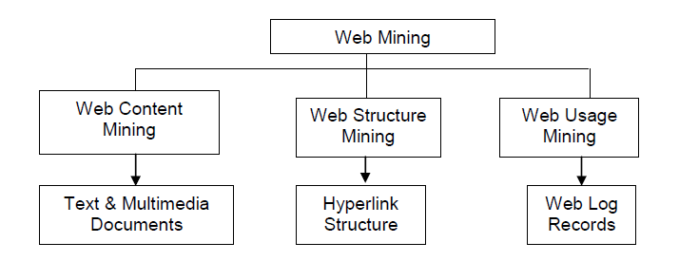

Slide 12
Web Content Mining
Web content mining targets the knowledge discovery, in which the main objects are the traditional collections of multimedia documents such as images, video, and audio, which are embedded in or linked to the web pages.

Slide 13
It is also quite different from Data mining because Web data are mainly semi-structured and/or unstructured, while Data mining deals primarily with structured data. Web content mining is also different from Text mining because of the semi-structure nature of the Web, while Text mining focuses on unstructured texts. Web content mining thus requires creative applications of Data mining and / or Text mining techniques and also its own unique approaches. In the past few years, there was a rapid expansion of activities in the Web content mining area.

Slide 14
Web content mining could be differentiated from two points of view: Agent based approach or Database approach. The first approach aims on improving the information finding and filtering. The second approach aims on modeling the data on the Web into more structured form in order to apply standard database querying mechanism and data mining applications to analyze it.

Slide 15
Web content mining problems/challenges
Data/Information extraction: Extraction of structured data from Web pages, such as products and search results is a difficult task. Two main types of techniques, machine learning and automatic extraction are used to solve this problem.
Web information integration and schema matching: Although the Web contains a huge amount of data, each web site (or even page) represents similar information differently. Identifying or matching semantically similar data is a very important problem with many practical applications.
Opinion extraction from online sources: There are many online opinion sources, e.g., customer reviews of products, forums, blogs and chat rooms. Mining opinions (especially consumer opinions) is of great importance for marketing intelligence and product benchmarking.

Slide 16
Knowledge synthesis: Concept hierarchies or ontology are useful in many applications. However, generating them manually is very time consuming. A few existing methods that explores the information redundancy of the Web will be presented. The main application is to synthesize and organize the pieces of information on the Web to give the user a coherent picture of the topic domain.
Segmenting web pages and detecting noise: In many Web applications, one only wants the main content of the Web page without advertisements, navigation links, copyright notices. Automatically segmenting Web page to extract the main content of the pages is interesting problem.

Slide 17
Web Structure Mining
Web Structure Mining focuses on analysis of the link structure of the web and one of its purposes is to identify more preferable documents. The different objects are linked in some way. The intuition is that a hyperlink from document A to document B implies that the author of document, A thinks document B contains worthwhile information.

Slide 18
Web structure mining helps in discovering similarities between web sites or discovering important sites for a particular topic or discipline or in discovering web communities. Simply applying the traditional processes and assuming that the events are independent can lead to wrong conclusions. However, the appropriate handling of the links could lead to potential correlations, and then improve the predictive accuracy of the learned models.

Slide 19
The goal of web structure mining is to generate structural summary about the web site and web page. Technically, w mainly focuses on the structure of inner-document, while w tries to discover the link structure of the hyperlinks at the inter-document level. Based on the topology of the hyperlinks, web structure mining will categorize the web pages and generate the information, such as the similarity and relationship between different web sites.

Slide 20
Web Usage Mining
Web usage mining focuses on techniques that could predict the behavior of users while they are interacting with the WWW.
Web usage mining, discover user navigation patterns from web data, tries to discover the useful information from the secondary data derived from the interactions of the users while surfing on the Web.

Slide 21
Web usage mining collects the data from Web log records to discover user access patterns of web pages. There are several available research projects and commercial tools that analyze those patterns for different purposes.
The insight knowledge could be utilized in personalization, system improvement, site modification, business intelligence and usage characterization.

Slide 22
Sequential pattern mining
In web server logs, a visit by a client is recorded over a period of time. The time stamp associated with a transaction in this case will be a time interval, which is determined and attached to the transaction during the data preprocesses. The discovery of sequential patterns in web server access logs allows web-based organizations to predict user navigation patterns, and helps in targeting advertising aimed at groups of users based on these patterns.

Slide 23
By analyzing this information, the Web mining system can determine temporal relationships among data items such as the following:
30% of clients who visited /company/products had done a search in Google, within the past week on keyword.
60% of clients, who placed an online order in/company/product1, also placed an online order in /company/product4 within 15 days.

Slide 24
Classification mining
Discovering classification rules allows one to develop a profile of items belonging to a particular group according to their common attributes. This profile can then be used to classify new data items that are added to the database.

Slide 25
Applications of Web Mining
A few applications are:
E-commerce Customer Behavior Analysis
E-commerce Transaction Analysis
E-commerce Website Design
E-banking
M-commerce
Web Advertisement
Search Engine
Online Auction

Slide 26
QUESTIONS?

